Slide 1


PARTNER DECK | 2026
Therapy should not end
when money runs out.
Therapy should be able to begin when there is no money.
Access to Therapy funds long-term counselling for adults who cannot afford to keep paying.
CANADIAN REGISTERED CHARITY • #724593611 RR 0001
Closing the gap between need and sustained care.
Notes:
Cover. Organization name and charity number are verified on the Access to Therapy website and CRA public profile.

Slide 2


The barrier is not willingness. It is affordability.
People can find a first appointment and still lose access before care has time to work.
41%
1 in 3
of Canadian adults with a diagnosed mental health disorder reported needs that were only partly met or unmet in 2024.
Canadians with a diagnosed mental health condition reported not getting care because of cost in 2023.
COST INTERRUPTS CONTINUITY
A referral is not enough when the next session is unaffordable.
Source: Canadian Institute for Health Information, 2025 (2024 unmet-needs data; 2023 cost-barrier data).
Access to Therapy Initiative | Registered Charity #724593611 RR 0001
Notes:
Source: CIHI, Many Canadians with mental health disorders are not having their needs met, published Oct. 23, 2025. 41% and one-in-three figures.

Slide 3

Access becomes care when support continues.
Access to Therapy removes the financial barrier and actively places people into ongoing counselling.
Fund
Match
Sustain
Cover 100% of approved counselling costs for adults facing financial hardship.
Connect each person directly with a participating practitioner based on fit and availability.
Support ongoing care without arbitrary session limits, subject to available program capacity.
Not a referral list. An active pathway into ongoing care.
Model description: Access to Therapy website, About Us and Programs pages.
Access to Therapy Initiative | Registered Charity #724593611 RR 0001
Notes:
Model details based on Access to Therapy About and Programs pages: funded care, practitioner partnerships, first-come queue, ongoing care without arbitrary limits subject to capacity.

Slide 4

How access becomes sustained care
A simple, fair pathway from application to ongoing sessions.
01
Apply
Complete the online intake and a brief waiver.
02
Queue
Join a first-come, first-served waitlist.
03
Match
Connect with an affiliated practitioner based on fit and availability.
FROM NEED
TO CONTINUITY
04
Continue
The practitioner manages scheduling; Access to Therapy funds eligible sessions.
The charity coordinates the pathway. The practitioner and client continue the therapeutic relationship.
Source: Access to Therapy website, About Us and Free Therapy program pages.
Access to Therapy Initiative | Registered Charity #724593611 RR 0001
Notes:
Process: online form, waiver, first-come waitlist, matching, ongoing care.

Slide 5
Proof of delivery, not a promise.
A growing program with measurable care already reaching people.
1,800+
200+
12+
counselling sessions funded
people helped
practitioners
8–12
15+
people supported at a time
people currently waiting
Every completed session represents a person who was able to continue.
Organization-reported impact through August 2026.
Access to Therapy Initiative | Registered Charity #724593611 RR 0001
Notes:
Impact figures are organization-reported as of August 2026.

Slide 6

A Western Canadian footprint, built for virtual scale.
Current service delivery spans four provinces through a network of independent practitioners.
National delivery
Excluding Quebec.
Virtual delivery
Distance is not the deciding factor.
Practitioner network
Provincial matching supports fit and continuity.
CURRENT VIRTUAL SERVICE FOOTPRINT
Built to expand
Additional funding can open more practitioner capacity.
Current footprint based on organization-reported service delivery, August 2026.
Access to Therapy Initiative | Registered Charity #724593611 RR 0001
Notes:
Current service footprint: British Columbia, Alberta, Saskatchewan, Manitoba; virtual delivery.

Slide 7
One donation can fund a measurable amount of care.
The current average direct cost is approximately $30 per counselling session.
$360
$1,500
$30
12 sessions
50 sessions
A three-month weekly start
A substantial block of care
1 counselling session
$5,000
$15,000
up to 166 sessions
up to 500 sessions
Direct, tangible, reportable.
A meaningful waitlist reduction
A major continuity partnership
Session equivalents use the current average direct cost of approximately $30. Final allocation depends on capacity and partnership terms.
Access to Therapy Initiative | Registered Charity #724593611 RR 0001
Notes:
The prior pitch deck states that every $30 funds one counselling session. Larger amounts are shown as session equivalents, not guarantees beyond capacity.

Slide 8

Stories of two people. Two sustained journeys.
“The process was smooth and compassionate, and I was matched with an incredible counsellor who walked alongside me through some of the hardest moments. This experience has been deeply healing.”
NAKITA • VICTORIA, BC
What continuity
feels like.
“After 14 weeks, I had made progress I was never able to make in 10 years of trying to heal on my own.”
HEATHER • KELOWNA, BC
Real outcomes, in the words of people served.
Testimonials: Access to Therapy website, About Us page. Excerpts condensed for presentation.
Access to Therapy Initiative | Registered Charity #724593611 RR 0001
Notes:
Testimonials from Access to Therapy About Us page. Excerpts condensed without changing the stated meaning.

Slide 9
A lean system turns funding into completed sessions.
Each step has a clear owner, a clear transaction, and a measurable outcome.
Partner funding
Intake & matching
Practitioner payment
Completed care
Impact reporting
Restricted or flexible support enters the program.
Applications, queue management, fit and availability.
Participating professionals are paid on schedule.
Sessions occur and continuity is sustained.
Partners can see what their support enabled.
“We do not fund ideas. We fund ongoing counselling - delivered, coordinated, and sustained.”
Operating model: Access to Therapy website and prior organizational pitch materials.
Access to Therapy Initiative | Registered Charity #724593611 RR 0001
Notes:
Flow depicts the organization’s operating model. Quote adapted from the original Access to Therapy pitch deck.

Slide 10
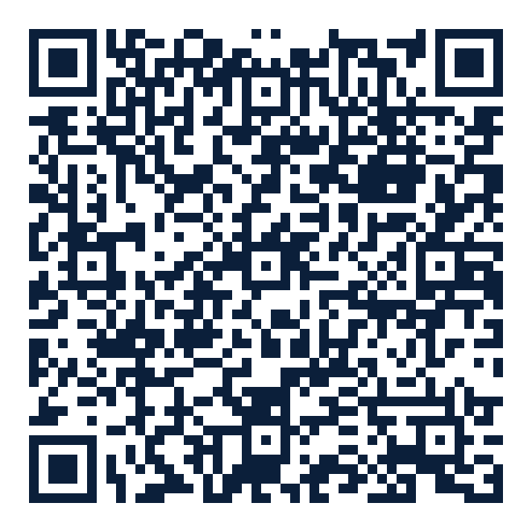
Public accountability: first CRA filing snapshot
Access To Therapy Initiative / Initiative D’accès à La Thérapie | BN 724593611RR0001
AS PER 2025 CRA RETURN
Revenue
Total expenditures
$19,763
$20,240
Management & admin
Closing assets
VIEW THE
PUBLIC CRA
RECORD
$1,881
$957
Liabilities: $0
$18,359 of $20,240 in reported expenditures
Access to Therapy Initiative | Registered Charity #724593611 RR 0001
Notes:
CRA filing snapshot for Sept. 18-Dec. 31, 2025. Figures: revenue 19,763; expenditures 20,240; charitable activities 18,359; management/admin 1,881; closing assets 957; liabilities 0. Public profile QR links to CRA.

Slide 11
The constraint is capacity — not demand.
New funding can move people from waiting to receiving sustained care.
WHAT ADDITIONAL FUNDING UNLOCKS
15+
More practitioner slots
Open new spaces without removing support from current clients.
people currently waiting
Shorter wait times
Move applicants into care sooner.
8–12 people supported at a time
Better matching
Increase the range of specialties, provinces and lived experience.
Demand is immediate, active, and already exceeds funded capacity.
Protected continuity
Reduce the risk that care stops because funding becomes uncertain.
Current capacity and waitlist are organization-reported as of August 2026.
Access to Therapy Initiative | Registered Charity #724593611 RR 0001
Notes:
Growth opportunity based on current reported active caseload and waitlist.

Slide 12
Four ways partners can participate
Built for one-time gifts, annual sponsorships, campaigns, and multi-year commitments.
Corporate & foundation
Campaigns & events
Creators & communities
Practitioner partnerships
Fund counselling, underwrite waitlist reduction, or support program capacity.
Create a public-facing campaign with a clear, session-based impact story.
Mobilize audiences through livestreams, challenges, tournaments, and peer fundraising.
Offer reduced-rate or pro bono capacity while receiving coordinated referrals and timely payment.
Custom recognition and impact reporting can be matched to the partnership — without distracting from care.
Partnership pathways reflect Access to Therapy’s donor, creator, corporate and practitioner engagement model.
Access to Therapy Initiative | Registered Charity #724593611 RR 0001
Notes:
Partnership pathways based on the prior deck and current organizational model.

Slide 13
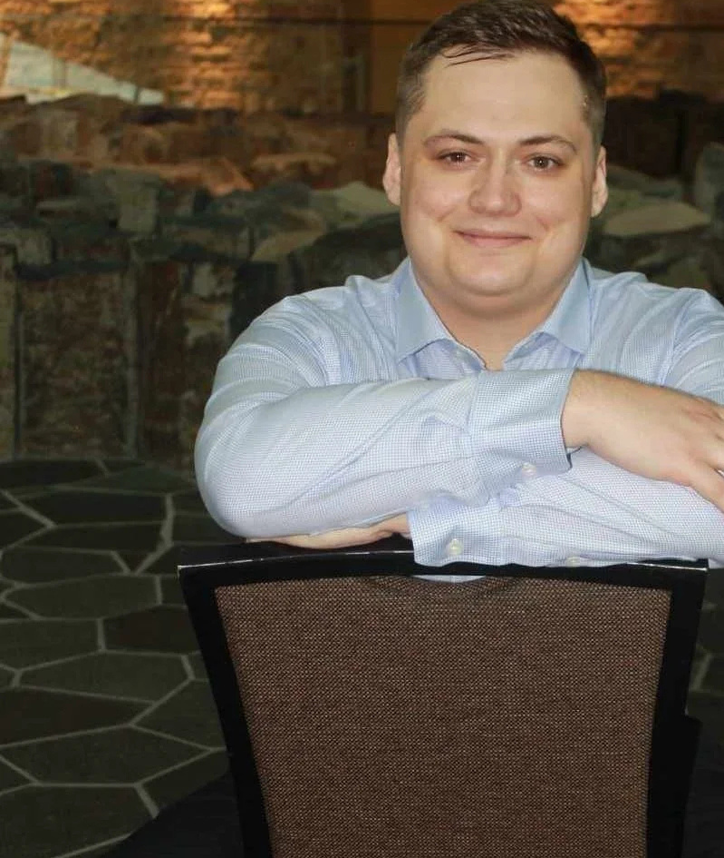
Built from lived experience. Governed for public benefit.
“No one should be left alone with serious pain simply because ongoing care is financially out of reach.”
Joshua Cecil (JC) Haney is a Métis community advocate, political science student, and the founder of Access to Therapy. He created the charity after navigating mental-health, disability and financial barriers firsthand - with the goal of making ongoing care depend on need, not income.
CURRENT BOARD
JC HANEY • FOUNDER & CHAIR
ANAM FATIMA • SECRETARY-TREASURER
JC HANEY
REYNA TORRES • PRESIDENT
BOARD-GOVERNED • PUBLIC CRA FILING
Founder & Chair
Leadership and founder biography: Access to Therapy website, Leadership page.
Access to Therapy Initiative | Registered Charity #724593611 RR 0001
Notes:
Current leadership listed on the Access to Therapy website: JC Haney, Founder and Chair; Anam Fatima and Jess Harrison, Board Members.

Slide 14
Choose the level of continuity you want to create.
Each level can be tailored as a donation, sponsorship, campaign, or multi-year partnership.
STARTER PARTNERSHIP
CONTINUITY PARTNER
WAITLIST IMPACT
STRATEGIC PARTNER
$5K
$15K
$30K
$60K+
up to 166 sessions
up to 500 sessions
up to 1,000 sessions
care + capacity
Direct-to-care session equivalent, aligned with available program capacity.
Direct-to-care session equivalent, aligned with available program capacity.
Direct-to-care session equivalent, aligned with available program capacity.
Combine direct care with the intake, matching and practitioner infrastructure needed to grow.
Multi-year commitments help protect clients from interrupted care. Start with a conversation.
Session equivalents use the current average direct cost of approximately $30; final allocations follow program capacity and partner agreement.
Access to Therapy Initiative | Registered Charity #724593611 RR 0001
Notes:
Funding levels are illustrative session equivalents based on the organization’s current approximate $30 direct session cost.

Slide 15


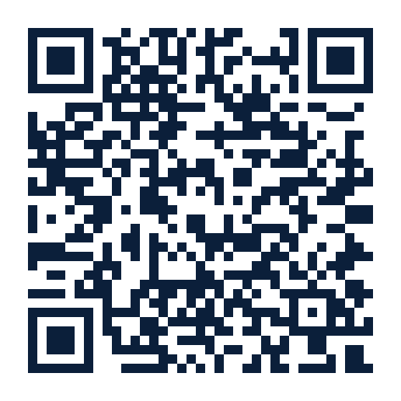
Fund the next session.
Sustain the next chapter.
Let’s build a partnership that moves people from waiting into ongoing care.
JC Haney • Founder & Chair
help@accesstotherapy.org
1-(204) 461-4213
accesstotherapy.org
DONATE / LEARN MORE
500-167 Lombard Avenue
Winnipeg, MB R3B 0V3
Registered Charity #724593611 RR 0001
Notes:
Contact details verified on Access to Therapy website. Donate QR links to https://www.accesstotherapy.org/donate.

Slide 16
Sources & presentation notes
Appendix | Updated August 24, 2026
Canadian Institute for Health Information (2025)
Many Canadians with mental health disorders are not having their needs met. Used for 41% unmet/partly met needs and 1-in-3 cost-barrier figures.
Access to Therapy website
Homepage, About Us, Programs, Free Therapy, Practitioners, Leadership and Donate pages. Used for the service model, testimonials, leadership, contact information and registered charity number.
Canada Revenue Agency public charity profile
Access To Therapy Initiative / Initiative D’accès à La Thérapie, BN 724593611RR0001. The deck links directly to the public profile.
Access to Therapy first T3010 filing
Short initial period Sept. 18-Dec. 31, 2025: revenue $19,763; expenditures $20,240; charitable activities $18,359; management/admin $1,881; closing assets $957; liabilities $0.
Organization-reported impact data
As of August 2026: 1,800+ sessions, 200+ people helped, 10+ practitioners/clinics, 8-12 people active at a time and 15+ waiting.
Session-equivalent note
Dollar-to-session examples use the current approximate $30 direct session cost. Actual allocation and timing depend on available practitioner capacity and the final partnership agreement.
This deck is designed as a master partner presentation; the ask and recognition can be tailored to each audience.
Access to Therapy Initiative | Registered Charity #724593611 RR 0001
Notes:
Appendix sources.

